Slide 1
USES-DATABASE TRIGGERS
Database triggers can be used to perform any of the following tasks:
Audit data modification.
Log events transparently.
Enforce complex business rules.
Prevent DML operations on a table after regular business hours
Derive column values automatically.
Implement complex security authorizations.
Maintain replicate tables.
Gather statistics on table access
Publish information about events for a publish-subscribe environment such as that associated with web programming.
Notes:
In software architecture, publish–subscribe is a messaging pattern where senders of messages, called publishers, do not program the messages to be sent directly to specific receivers, called subscribers.
The simple request/response nature of a standard Web application requires that all communication be initiated by the client; this means that the server can only push updated data to its clients if it receives an explicit request. This mechanism is adequate for traditional applications, such as shopping carts, in which data from the server is required only when a client requests it, but inadequate for dynamic real-time applications such as chat rooms and auction updates in which the server must send data even if a client has not explicitly requested it. The client can use the traditional HTTP pull approach to check and retrieve the latest data at regular intervals.
The Bayeux protocol defines a contract between the client and the server for communicating with asynchronous messages over HTTP. It allows clients to register and subscribe to channels, which are named destinations or sources of events. Registered clients, or the pub-sub server itself, then publishes messages to these channels which in turn any subscribed clients receive.

Slide 2
Difference between Trigger and Constraints
Trigger affects only those rows, which are added after it is created.
Constraints affects all the rows
i.e. Validates the even already existing data before defining the constraint.

Slide 3
Triggers:
are named PL/SQL blocks with declarative, executable, and exception handling sections.
are stand-alone database objects
do not accept arguments.
To create/test a trigger, you (not the ‘system’ user of the trigger) must have appropriate access to all objects referenced by a trigger action.
Example: To create a BEFORE INSERT trigger for the employee table requires you to have INSERT ROW privileges for the table.
Notes:
To create/test a trigger, you (not the ‘system’ user of the trigger) must have appropriate access to all objects referenced by a trigger action.

Slide 4
Create Trigger Syntax
CREATE [OR REPLACE] TRIGGER trigger_name
BEFORE|AFTER|INSTEAD OF triggering_event ON table_name | view_name [referencing_clause]
[WHEN condition] [FOR EACH ROW]
[DECLARE
Declaration statements]
BEGIN
Executable statements
[EXCEPTION
Exception-handling statements]
END;
The trigger body must have at least the executable section.
The declarative and exception handling sections are optional.
When there is a declarative section, the trigger body must start with the DECLARE keyword.
The WHEN clause specifies the condition under which a trigger should fire.
Notes:
List All Triggers in Oracle Database
The user_triggers View. The user_triggers view describes the triggers owned by the current user. ...
The all_triggers View. The all_triggers view describes the triggers on tables accessible to the current user. ...
The dba_triggers View. The dba_triggers view lists all triggers in the database:

Slide 5
DATABASE TRIGGERS
Database trigger – a stored PL/SQL program unit that is associated with a specific database table, or with certain view types and can be fired automatically in response to any DML events or a system event such as database startup.
Two sections:
A named database event
A PL/SQL block that will execute when the event occurs

Slide 6
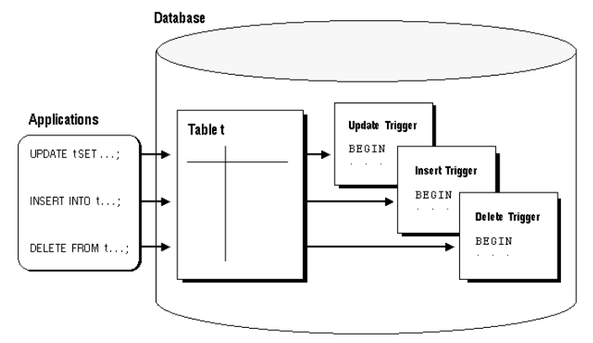
Database Trigger
Triggers get executed (fire) automatically when specified SQL DML operations – INSERT, UPDATE, or DELETE affecting one or more rows of a table.
Notes:
Taken from: https://docs.oracle.com/cd/A57673_01/DOC/server/doc/SCN73/ch15.htm

Slide 7
Trigger Types
BEFORE and AFTER Triggers – trigger fires before or after the triggering event. Applies only to tables.
INSTEAD OF Trigger – trigger fires instead of the triggering event. Applies only to views.
Triggering event – a DML statement issued against the table or view named in the ON clause – example: INSERT, UPDATE, or DELETE.
DML triggers are fired by DML statements and are referred to sometimes as row triggers.
FOR EACH ROW clause – a ROW trigger that fires once for each modified row.
STATEMENT trigger – fires once for the DML statement.
Referencing_clause – enables writing code to refer to the data in the row currently being modified by a different name.
Notes:
https://docs.oracle.com/cd/A57673_01/DOC/server/doc/SCN73/ch15.htm
Statement Triggers A statement trigger is fired once on behalf of the triggering statement, regardless of the number of rows in the table that the triggering statement affects (even if no rows are affected). For example, if a DELETE statement deletes several rows from a table, a statement-level DELETE trigger is fired only once, regardless of how many rows are deleted from the table.
Statement triggers are useful if the code in the trigger action does not depend on the data provided by the triggering statement or the rows affected. For example, if a trigger makes a complex security check on the current time or user, or if a trigger generates a single audit record based on the type of triggering statement, a statement trigger is used.
BEFORE Triggers BEFORE triggers execute the trigger action before the triggering statement. This type of trigger is commonly used in the following situations:
BEFORE triggers are used when the trigger action should determine whether the triggering statement should be allowed to complete. By using a BEFORE trigger for this purpose, you can eliminate unnecessary processing of the triggering statement and its eventual rollback in cases where an exception is raised in the trigger action.
BEFORE triggers are used to derive specific column values before completing a triggering INSERT or UPDATE statement.
AFTER Triggers AFTER triggers execute the trigger action after the triggering statement is executed. AFTER triggers are used in the following situations:
AFTER triggers are used when you want the triggering statement to complete before executing the trigger action.
If a BEFORE trigger is already present, an AFTER trigger can perform different actions on the same triggering statement.
Combinations
Using the options listed in the previous two sections, you can create four types of triggers:
BEFORE statement trigger Before executing the triggering statement, the trigger action is executed.
BEFORE row trigger Before modifying each row affected by the triggering statement and before checking appropriate integrity constraints, the trigger action is executed provided that the trigger restriction was not violated.
AFTER statement trigger After executing the triggering statement and applying any deferred integrity constraints, the trigger action is executed.
AFTER row trigger After modifying each row affected by the triggering statement and possibly applying appropriate integrity constraints, the trigger action is executed for the current row provided the trigger restriction was not violated. Unlike BEFORE row triggers, AFTER row triggers lock rows.
You can have multiple triggers of the same type for the same statement for any given table. For example you may have two BEFORE STATEMENT triggers for UPDATE statements on the EMP table. Multiple triggers of the same type permit modular installation of applications that have triggers on the same tables. Also, Oracle snapshot logs use AFTER ROW triggers, so you can design your own AFTER ROW trigger in addition to the Oracle-defined AFTER ROW trigger.You can create as many triggers of the preceding different types as you need for each type of DML statement (INSERT, UPDATE, or DELETE). For example, suppose you have a table, SAL, and you want to know when the table is being accessed and the types of queries being issued. Figure 15 - 4 contains a sample package and trigger that tracks this information by hour and type of action (for example, UPDATE, DELETE, or INSERT) on table SAL. A global session variable, STAT.ROWCNT, is initialized to zero by a BEFORE statement trigger, then it is increased each time the row trigger is executed, and finally the statistical information is saved in the table STAT_TAB by the AFTER statement trigger.
DROP TABLE stat_tab; CREATE TABLE stat_tab(utype CHAR(8), rowcnt INTEGER, uhour INTEGER); CREATE OR REPLACE PACKAGE stat IS rowcnt INTEGER; END; / CREATE TRIGGER bt BEFORE UPDATE OR DELETE OR INSERT ON sal BEGIN stat.rowcnt := 0; END; / CREATE TRIGGER rt BEFORE UPDATE OR DELETE OR INSERT ON sal FOR EACH ROW BEGIN stat.rowcnt := stat.rowcnt + 1; END; / CREATE TRIGGER at AFTER UPDATE OR DELETE OR INSERT ON sal DECLARE typ CHAR(8); hour NUMBER; BEGIN IF updating THEN typ := 'update'; END IF; IF deleting THEN typ := 'delete'; END IF; IF inserting THEN typ := 'insert'; END IF; hour := TRUNC((SYSDATE - TRUNC(SYSDATE)) * 24); UPDATE stat_tab SET rowcnt = rowcnt + stat.rowcnt WHERE utype = typ AND uhour = hour; IF SQL%ROWCOUNT = 0 THEN INSERT INTO stat_tab VALUES (typ, stat.rowcnt, hour); END IF; EXCEPTION WHEN dup_val_on_index THEN UPDATE stat_tab SET rowcnt = rowcnt + stat.rowcnt WHERE utype = typ AND uhour = hour; END; /

Slide 8
Conditional Predicates for Detecting Triggering DML Statement
Conditional Predicate | TRUE if and only if:
INSERTING | An INSERT statement fired the trigger.
UPDATING | An UPDATE statement fired the trigger.
UPDATING ('column') | An UPDATE statement that affected the specified column fired the trigger.
DELETING | A DELETE statement fired the trigger.

Slide 9
SET SERVEROUTPUT On
CREATE OR REPLACE TRIGGER trig1
BEFORE INSERT OR UPDATE OF sal, deptno OR
DELETE ON emp FOR EACH ROW
BEGIN
CASE
WHEN INSERTING THEN
DBMS_OUTPUT.PUT_LINE('Inserting');
WHEN UPDATING('sal') THEN
DBMS_OUTPUT.PUT_LINE('Updating salary');
WHEN UPDATING('Deptno') THEN
DBMS_OUTPUT.PUT_LINE('Updating department ID');
WHEN DELETING THEN
DBMS_OUTPUT.PUT_LINE('Deleting');
END CASE; END;
/
Example-1: A trigger program to display the trigger event that resulted into trigger execution
Save the file – trg1_ex.sql
SQL>@ trg1_ex.sql
Trigger created.
If errors
SQL> SHOW ERRORS TRIGGER trig1
SQL> insert into emp(empno, ename, sal, deptno) values(119,'Akshay',3400,10);
Inserting
Notes:
User: lab p:vm
D:\MCA 2022\Jan-2022\Ora-Exer\Triggers\Trg0.sql

Slide 10
ROW Trigger – Accessing Rows
Access data on the row currently being processed by using two correlation identifiers named :old and :new. These are special Oracle bind variables.
The PL/SQL compiler treats the :old and :new records as records of type trigger_Table_Name%ROWTYPE.
To reference a column in the triggering table, use the notation shown here where the ColumnName value is a valid column in the triggering table.
:new.ColumnName
:old.ColumnName

Slide 11
Bind Variables :old and :new Defined
DML Statement | :old | :new
INSERT | Undefined – all column values are NULL as there is no “old” version of the data row being inserted. | Stores the values that will be inserted into the new row for the table.
UPDATE | Stores the original values for the row being updated before the update takes place. | Stores the new values for the row – values the row will contain after the update takes place.
DELETE | Stores the original values for the row being deleted before the deletion takes place. | Undefined – all column values are NULL as there will not be a “new” version of the row being deleted.

Slide 12
Example
CREATE TABLE Emp_log (
Emp_id NUMBER(4),
Log_date DATE,
Old_salary NUMBER(7,2),
New_salary NUMBER(7,2),
Action VARCHAR2(20),
User_name varchar2(10));
This table records the salary change events.
CREATE TABLE Emp (
Empno NUMBER(4),
Name varchar2(10),
salary NUMBER(7,2),
Deptno VARCHAR2(20));
This table contains employee information
Example: Create a trigger to store salary change information into EMP_log table , when salary changes is made to EMP table. It has record information such as- Whose Salary has been changed, when changed, old and new values of salary, Action(I-increase, D-Decrease), User who initiated the change.
Notes:
Create a trigger to record the salary changes made to EMP_log table, it has record information such as- Whose Salary has been changed, when changed, old and new values of salary, Action(I-increase, D-Decrease), User who initiated the change.

Slide 13
Example-2
CREATE OR REPLACE TRIGGER log_salary_increase
AFTER UPDATE OF sal ON emp
FOR EACH ROW
DECLARE
user_action VARCHAR2(1);
BEGIN
if(:new.sal>:old.sal) then
user_action:='I';
elsif :new.sal=:old.sal then
user_action:='N';
else
user_action:='D';
end if;
INSERT INTO Emp_log
VALUES (:NEW.empno, SYSDATE,:old.sal, :NEW.sal,user_action ,User);
END;
/
Notes:
User: lab p:vm
D:\MCA 2022\Jan-2022\Ora-Exer\Triggers\Trg1.sql
CREATE OR REPLACE TRIGGER log_salary_increase
AFTER UPDATE OF sal ON emp
FOR EACH ROW
DECLARE
user_action VARCHAR2(1);
BEGIN
if(:new.sal>:old.sal) then
user_action:='I';
elsif :new.sal=:old.sal then
user_action:='N';
else
user_action:='D';
end if;
INSERT INTO Emp_log (Emp_id, Log_date,old_salary, New_salary, Action,
user_name)
VALUES (:NEW.empno, SYSDATE,:old.sal, :NEW.sal,user_action ,User);
END;
/

Slide 14
WHEN clause- to specify condition under which Trigger has to fire
Example 3: Create a trigger to store salary change information into EMP_log table , when salary changes above 90000 is made to EMP table. It has record information such as- Whose Salary has been changed, when changed, old and new values of salary, Action(I-increase, D-Decrease), User who initiated the change.

Slide 15
Example-3
CREATE OR REPLACE TRIGGER log_salary_increase_when
AFTER UPDATE OF sal ON emp1 FOR EACH ROW WHEN (new.sal>90000)
DECLARE
user_action VARCHAR2(1);
BEGIN
if(:new.sal>:old.sal) then
user_action:='I';
elsif :new.sal=:old.sal then
user_action:='N';
else
user_action:='D';
end if;
INSERT INTO Emp_log1
VALUES (:NEW.empno, SYSDATE,:old.sal, :NEW.sal,user_action ,User);
END;
/
Notes:
D:\DSCA-2022\2020\DBMS-2020\DBMS-2020 Desktop\Ora-Exer\Triggers\Trg1_1.sql (user:hr, pass:hr)
User: lab p:vm
D:\MCA 2022\Jan-2022\Ora-Exer\Triggers\Trg1.sql
CREATE OR REPLACE TRIGGER log_salary_increase
AFTER UPDATE OF sal ON emp
FOR EACH ROW
DECLARE
user_action VARCHAR2(1);
BEGIN
if(:new.sal>:old.sal) then
user_action:='I';
elsif :new.sal=:old.sal then
user_action:='N';
else
user_action:='D';
end if;
INSERT INTO Emp_log (Emp_id, Log_date,old_salary, New_salary, Action,
user_name)
VALUES (:NEW.empno, SYSDATE,:old.sal, :NEW.sal,user_action ,User);
END;
/
User: hr , pass: hr
CREATE OR REPLACE TRIGGER log_salary_increase1
AFTER INSERT OR UPDATE OF sal ON emp FOR EACH ROW WHEN (NEW.sal>90000)
BEGIN
IF Inserting THEN
INSERT INTO Emp_log1 (Emp_id, Log_date, New_sal, Action,
user_name)
VALUES (:NEW.empno, SYSDATE, :NEW.sal, 'Invalid Insert',User);
end if;
IF Updating THEN
INSERT INTO Emp_log1 (Emp_id, Log_date, old_sal, Action,
user_name)
VALUES (:OLD.empno, SYSDATE, :OLD.sal, 'Invalid Update',User);
end if;
END;
/

Slide 16
STATEMENT Trigger - Example
Write a trigger to validate the salary updating action only during week-days
Note: Salary update statement may be updating multiple rows but Trigger
is executed only once because It is System Trigger therefore FOR EACH ROW is not used
--User hr p: hr create another table EMP2 copy of EMP;
create or replace trigger sal_update_weekDays before update of sal on emp2
begin
if to_char(sysdate,'DY') = 'SUN' then
raise_application_error(-20111,'No changes can be made on Sunday.');
end if;
end;
/
Notes:
User lab p: vm
D:\MCA 2022\Jan-2022\Ora-Exer\Triggers\t.sql
Note: it is System Trigger therefore FOR EACH ROW is not used

Slide 17
STATEMENT Trigger - Example
/* CREATE TABLE users_log(User_name varchar2(10),Operation varchar2(10),Login_Date Date);*/
CREATE OR REPLACE TRIGGER note_hr_logon_trigger
AFTER LOGON ON HR.SCHEMA
BEGIN
INSERT INTO users_log VALUES (USER, 'LOGON', SYSDATE);
END;
/
Notes:
A schema is a collection of logical structures of data, or schema objects.
A schema is owned by a database user and has the same name as that user. Each user owns a single schema.
https://docs.oracle.com/cd/A57673_01/DOC/server/doc/SCN73/ch15.htm--user lab p:vm
D:\MCA 2022\Jan-2022\Ora-Exer\Triggers\Logon_trg.sql

Slide 18
Using Correlation Variable- Trigger - Example
create table new (id number, new number);
insert into new values(1,10); insert into new values(2,30);
create or replace trigger trig_coRelVariable
after update on new referencing old as old_rowtyp new as new_rowtyp
for each row
begin
if updating then
DBMS_OUTPUT.PUT_LINE('OLD VALUE '||:old_rowtyp.new||' NEW VALUE '||:new_rowtyp.new);
else
DBMS_OUTPUT.PUT_LINE(' SOme Error ...');
end if;
end;
/

Slide 19
Dropping a Trigger
The DROP TRIGGER statement drops a trigger from the database.
If you drop a table, all associated table triggers are also dropped.
The syntax is:
DROP TRIGGER trigger_name;

Slide 20
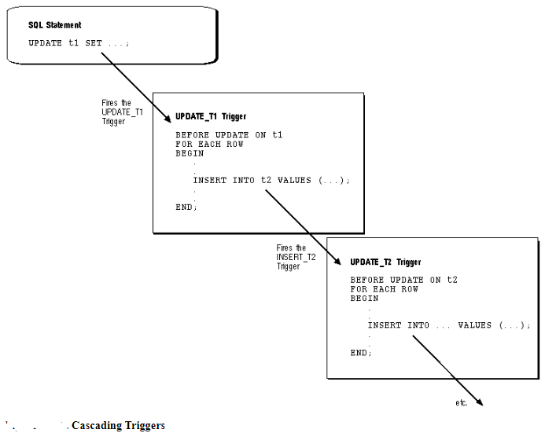
A Cautionary Note
When a trigger is fired, a SQL statement within its trigger action potentially can fire other triggers, . When a statement in a trigger body causes another trigger to be fired, the triggers are said to be cascading.
https://docs.oracle.com/cd/A57673_01/DOC/server/doc/SCN73/ch15.htm

Slide 21
Temporarily enabling/disabling trigger
To disable a trigger, you use the ALTER TRIGGER DISABLE statement
Syntax;
ALTER TRIGGER trigger_name DISABLE;
Example:
ALTER TRIGGER sal_update_weekDays_trg DISABLE;
To disable all triggers on a Table
Syntax:
ALTER TABLE table_name DISABLE ALL TRIGGERS;
Example :
ALTER TABLE Emp DISABLE ALL TRIGGERS;
Notes:
ALTER TRIGGER LOG_SALARY_INCREASE1 DISABLE;
ALTER TRIGGER LOG_SALARY_INCREASE1 ENABLE;

Slide 22
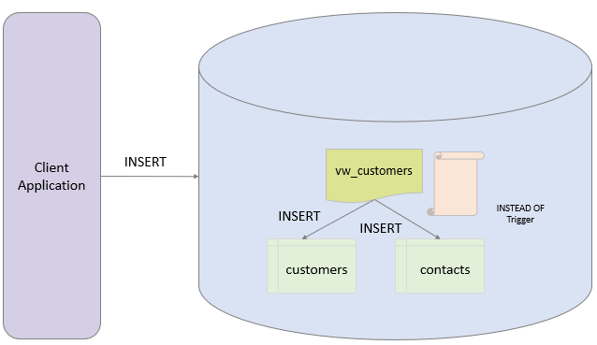
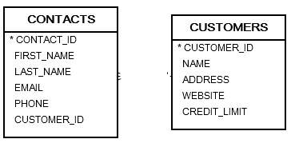
INSTEAD OF Trigger
Many to 1
CREATE VIEW vw_customers AS SELECT name, address, website, credit_limit, first_name, last_name, email, phone FROM customers Cust,contacts Cont where Cust.Customer_id=Cont.Customer_id;
Notes:
Taken from : https://www.oracletutorial.com/plsql-tutorial/oracle-instead-of-triggers/
Many to 1

Slide 23
INSTEAD OF Trigger
Example: Create a view VW_emp3_dept3 based on Emp(Empno, ename, sal, deptno) & Dept(Deptno, Dname,Loc). Write a trigger to update base tables Dept,Emp whenever VW_emp_dept view is updated.
set serveroutput on;
CREATE OR REPLACE TRIGGER emp_dept_InsteadoF_trg
INSTEAD OF INSERT ON VW_emp3_dept3 FOR EACH ROW
DECLARE
BEGIN
DBMS_OUTPUT.PUT_LINE(' Entered deptno '||:new.deptno);
insert into dept3 values(:new.deptno,:new.dname,null);
insert into emp3 (empno,ename,deptno) values(:new.empno,:new.ename,:new.deptno);
end;
/
Notes:
create view vw_emp_dept as select empno,ename,d.deptno,dname from emp e,dept d where e.deptno=d.deptno;
User hr pass: hr
CREATE OR REPLACE TRIGGER emp_dept_InsteadoF_trg
INSTEAD OF INSERT ON VW_emp_dept
FOR EACH ROW
DECLARE
no_of_rec Number(2):=10;
BEGIN
DBMS_OUTPUT.PUT_LINE(' Entered deptno '||:new.deptno);
insert into dept values(:new.deptno,:new.dname,null);
insert into emp (empno,ename,deptno) values(:new.empno,:new.ename,:new.deptno);
end;
/
Create a view VW_emp3_dept3 based on Emp3(Empno,ename,sal,deptno) & Dept3(Deptno,Dname,Loc,Budget)
-- user : lab p: vm
D:\MCA 2022\Jan-2022\Ora-Exer\Triggers\instd_of_trg1.sql
set serveroutput on
drop trigger emp_dept_InsteadoF_trg;
CREATE OR REPLACE TRIGGER emp_dept_InsteadoF_trg
INSTEAD OF INSERT ON VW_emp3_dept3
FOR EACH ROW
DECLARE
no_of_rec Number(2):=10;
BEGIN
DBMS_OUTPUT.PUT_LINE(' Entered deptno '||:new.deptno);
insert into dept3 values(:new.deptno,:new.dname,null,null);
insert into emp3 (empno,ename,deptno) values(:new.empno,:new.ename,:new.deptno);
end;
/
D:\MCA 2022\Jan-2022\Ora-Exer\Triggers\instd_of_trg2.sql
set serveroutput on;
Drop trigger emp_dept_InsteadoF_trg2;
CREATE OR REPLACE TRIGGER emp_dept_InsteadoF_trg2
INSTEAD OF INSERT ON VW_emp4_dept4 FOR EACH ROW
DECLARE
no_of_rec Number(2);
BEGIN
DBMS_OUTPUT.PUT_LINE(' Entered deptno '||:new.deptno);
select deptno into no_of_rec from dept4 where deptno=:new.deptno;
if(SQL%rowcount>0) THEN
DBMS_OUTPUT.PUT_LINE('Deaprtment '||:new.deptno||' EXISTS '||no_of_rec);
DBMS_OUTPUT.PUT_LINE(' Rows '||sql%rowcount);
DBMS_OUTPUT.PUT_LINE(' Insering only employee record ');
insert into emp4 (empno,ename,deptno) values(:new.empno,:new.ename,:new.deptno);
end if;
EXCEPTION
WHEN no_data_found THEN
DBMS_OUTPUT.PUT_LINE(' Deptno entered is unique,not existing in table dept ');
insert into dept4 values(:new.deptno,:new.dname,null,null);
insert into emp4 (empno,ename,deptno) values(:new.empno,:new.ename,:new.deptno);
end;
/

Slide 24
END

